Slide 1
Understanding the Impact of Hidden Disabilities on Reentry Population Success: Just Because You Don’t See It Doesn’t Mean It Isn’t There
Cherie Takemoto, New Editions Consulting
December 3, 2015

Slide 2
Successful Reentry: Against all Odds
Why do you do this?

Slide 3
Impact of Hidden Disabilities on Reentry Population Success: Just Because You Don’t See It Doesn’t Mean It Isn’t There
Consider a conceptual framework to improve success within reentry systems and for individuals with hidden disabilities.
Understand how a hidden disability might affect reentry success (Mental Illness and Traumatic Brain Injury).
Think about how reentry barriers and assets might be the same or different when considering hidden disabilities.
Become familiar with some disability services and supports available for addressing barriers.
Share what you can use now and what you need next.

Slide 4
Framework for Individual and System Success
(A Glimpse)
Strengths | Resources | Opportunities

Slide 5
Just because you don’t see it doesn’t mean it isn’t there….

Slide 6
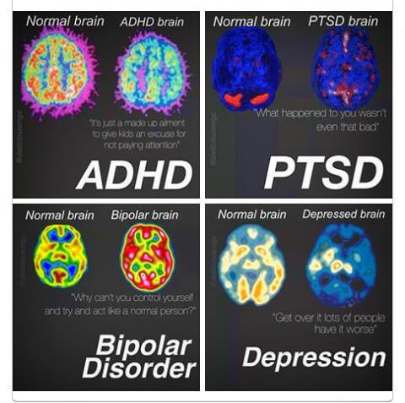
Just because you can't see it doesn't mean it is not there. Just because someone looks okay, doesn't mean they are. Know the facts, fight the stigma.
#equaltreatmentformentalhealth

Slide 7
Mental Illness Risk Factors
Prior history of crime/violence and early age at time of first offense
Executive functioning
Memory
Environmental stress
Treatment non adherence
Personality disorders
Substance abuse

Slide 8
Mental Illness & Criminal Justice
Prevalence of mental illness in adults is 4.1% vs 8-19% with significant psychiatric or functional disability.
An estimated 36.6% of prison inmates and 43.7% of jail inmates reported they were told by a mental health professional that they had a mental health disorder.
Probation:
  Those previously incarcerated with mental health challenges are returning due to noncompliance with their probation requirements (not reoffending).
  52-62% of parolees return to prison <1 year vs. 30% without mental illness (Skeem, 2011).
Require complex treatment, serviced and supervision strategies with an intertwined system (justice, mental health, hospitals, clinics and the welfare system.
Human Rights Watch - Callous and Cruel: Use of Force against Inmates with Mental Disabilities in US Jails and Prisons
https://www.hrw.org/report/2015/05/12/callous-and-cruel/use-force-against-inmates-mental-disabilities-us-jails-and

Slide 9
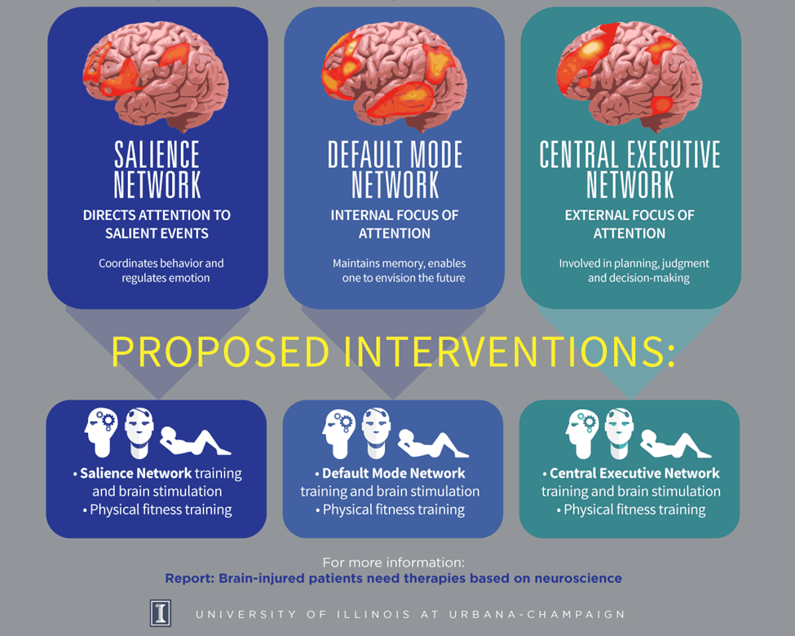
Traumatic
Brain
Injury
https://news.illinois.edu/infographics/braintrauma-infographic.pdf

Slide 10
TBI Risk Factors
Reduced awareness, impaired ability to focus and/or shift attention (salience network)
Impaired episodic memory, including orientation and memory loss (default mode network)
Impaired planning, judgment and decision-making (central executive network)
May have multiple TBIs
Mental health issues such as severe depression, anxiety, difficulty controlling anger
Substance abuse
May be physical impairments

Slide 11
TBI and Criminal Justice
25-87% of inmates compared to 8.5% of the general population
Significant difference in levels of drug use compared with inmates without reported TBI
Among male inmates, TBI strongly associated with domestic violence.
Female inmates convicted of a violent crime more likely to have sustained a pre-crime TBI and/or physical abuse
Children and teens convicted of crime more likely to have sustained a pre-crime TBI
http://www.cdc.gov/traumaticbraininjury/pdf/Prisoner_Crim_Justice_Prof-a.pdf

Slide 12
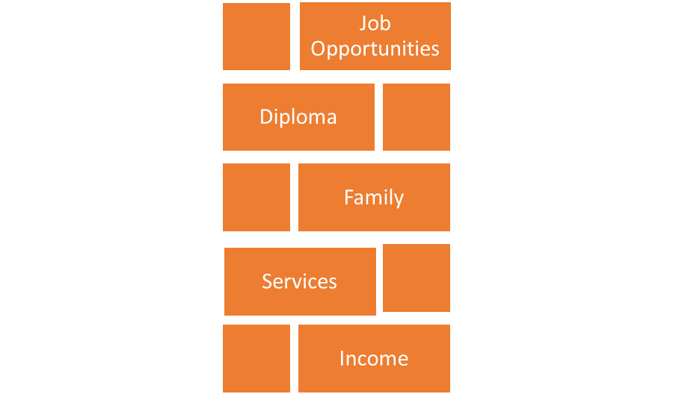
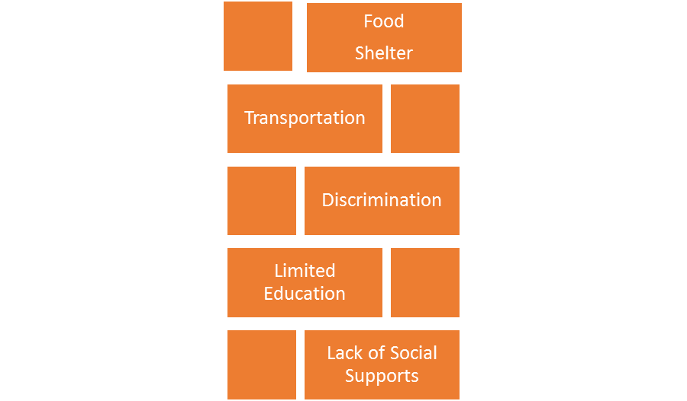
Reentry Barriers & Assets

Slide 13

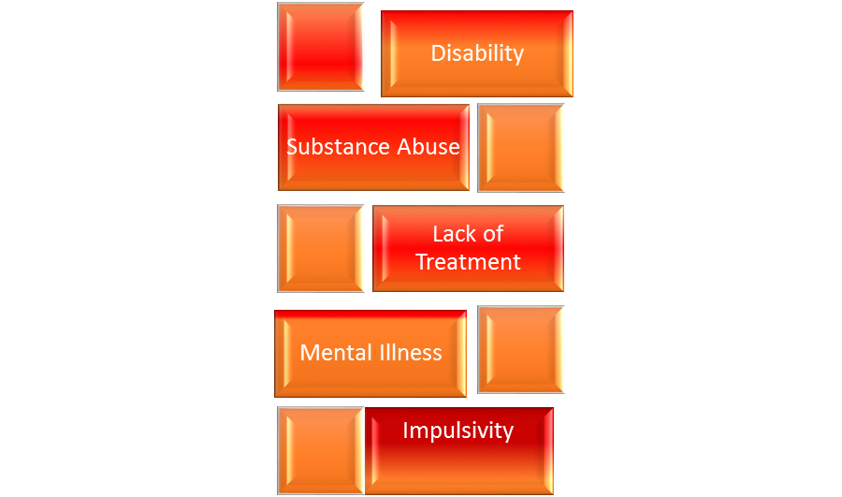
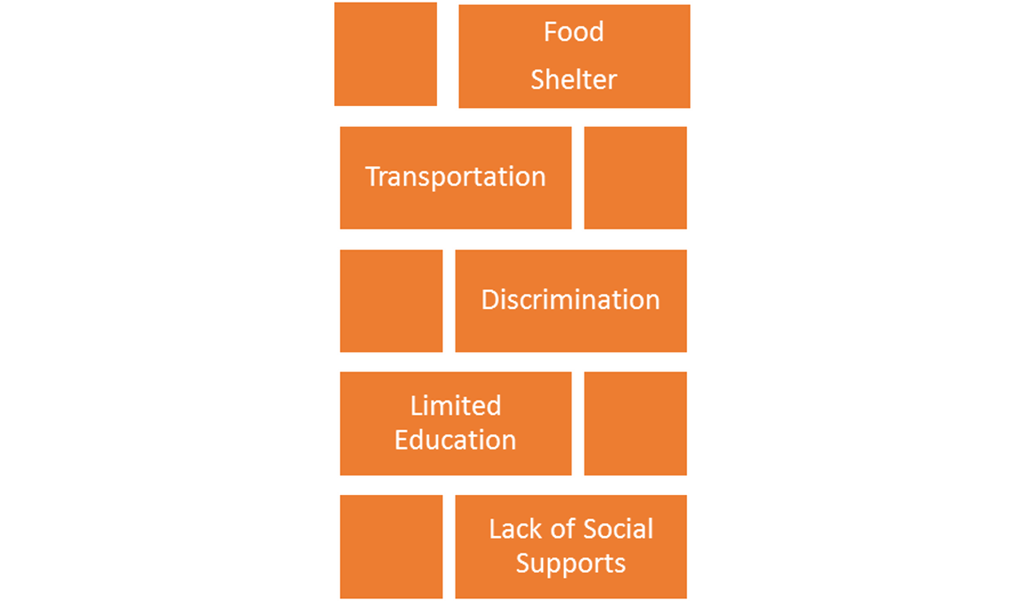
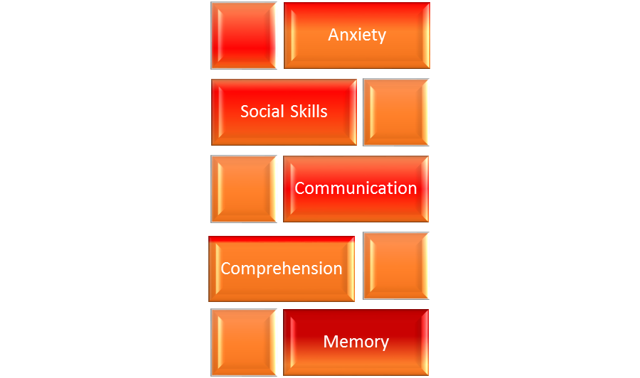
Individual Disability Factors Affecting Reentry

Slide 14
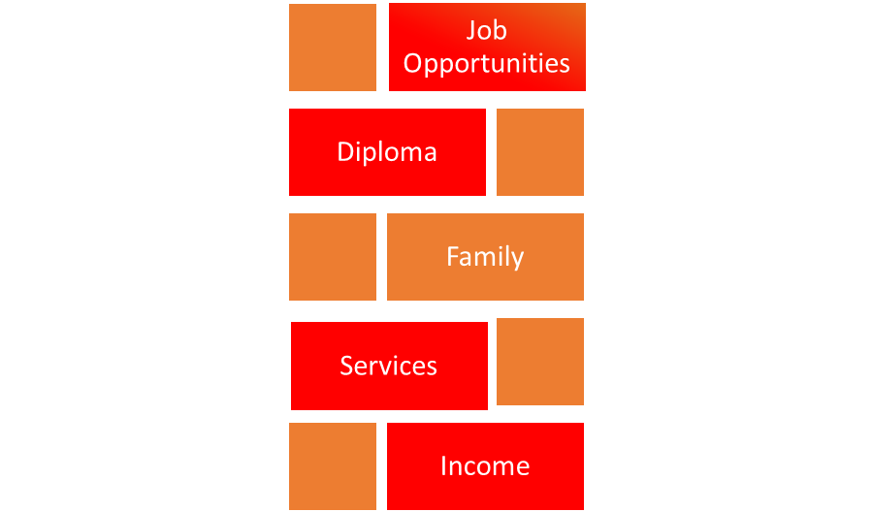
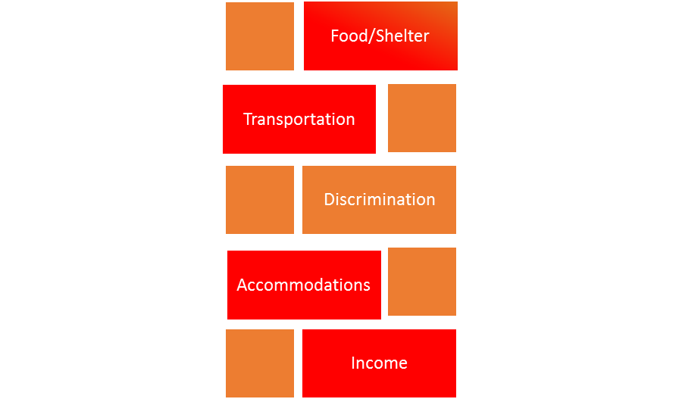
Disability Barriers Services & Supports

Slide 15
Framework for Individual and System Success
Strengths | Resources | Opportunities

Slide 16
What can you use now?
What do you need next?

Slide 17
Resources
Special Education – Transition services through age 22
  Guidance for Youth in Corrections Agencies
  Improving Transition Outcomes for Youth involved in the Juvenile Justice System
Assessment – Special Education <21 w/o regular diploma or State Rehabilitation Agencies– includes what person will need in order to learn
Income Support – SSI/SSDI
  What Prisoners Need to Know about SSI
Mental Health and Substance Abuse Treatment – eligibility for Medicaid for people eligible for SSI
  Medicaid information including the Mental Health Parity and Addiction Equity Act and other services covered through Medicaid.

Slide 18
Resources
Accommodations – State Protection & Advocacy specifically for people with disabilities who encounter an absence of justice in a system not designed to handle a large number of persons with disabilities.
Community Colleges
  Students with Disabilities Preparing for Postsecondary Education: Know Your Rights and Responsibilities
Job Opportunities – State Rehabilitation Agencies provide can provide job training, placement and support for eligible individuals.
  Link to State information from the Rehabilitation Services Administration

Slide 19
Resources
Housing – some programs specifically for people with disabilities including people with certain disabilities such as mental illness and TBI. Olmstead Act and Fair Housing Act are two important laws for the right to housing for people with disabilities.
  Disability.gov has a Guide to Housing for this and much more.
Federal Traumatic Brain Injury Program State Grants (as of October 1, 2015, this program moved to from HSRA to the Administration on Community Living.
  Traumatic Brain Injury in Prisons and Jails: an Unrecognized Problem (CDC Publication)
  Traumatic Brain Injury: A Guide for Criminal Justice Professionals

